Slide 1

Supervised Learning Exercise

Slide 2
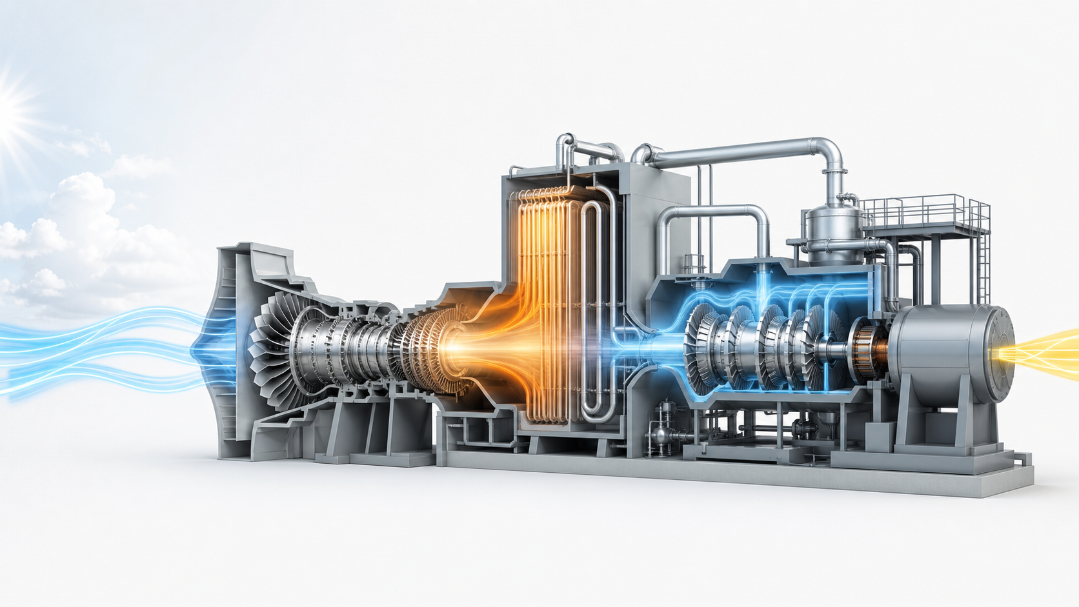
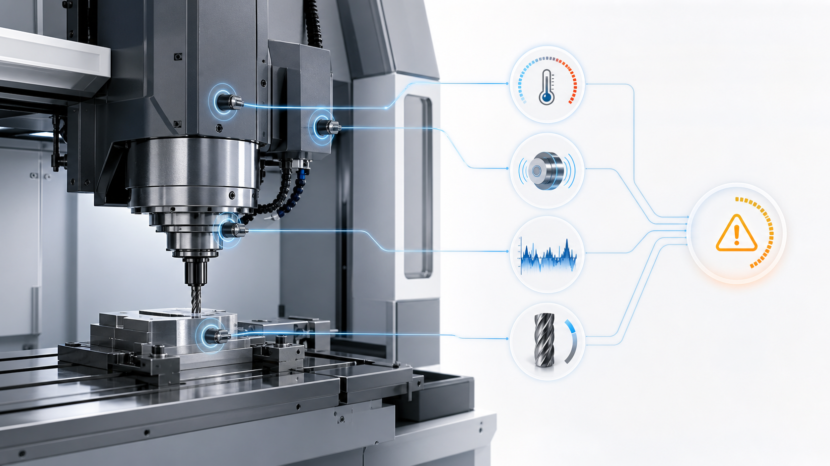
Two industrial cases
Case 1
Case 2
Combined-cycle power plant
CNC (computer numerical control) milling machine
Gas and steam turbines generate electricity
Ambient conditions change available output
Goal: Forecast net electrical output
Rotating tools shape metal components
Operating conditions can trigger failures
Goal: Raise reliable maintenance alarms
2

Slide 3
Two industrial cases
Case 1
Case 2
Combined-cycle power plant
CNC (computer numerical control) milling machine
Historical inputs
Train model
Predict new outcome
measured outcomes
3

Slide 4
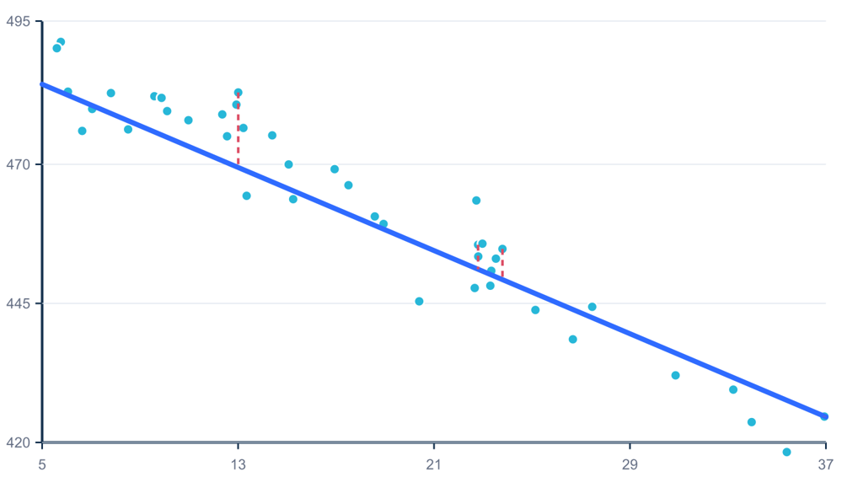
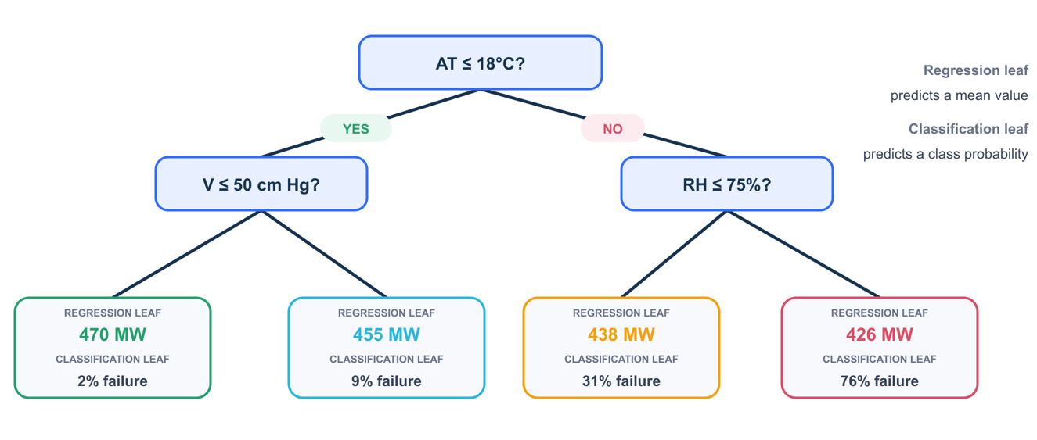
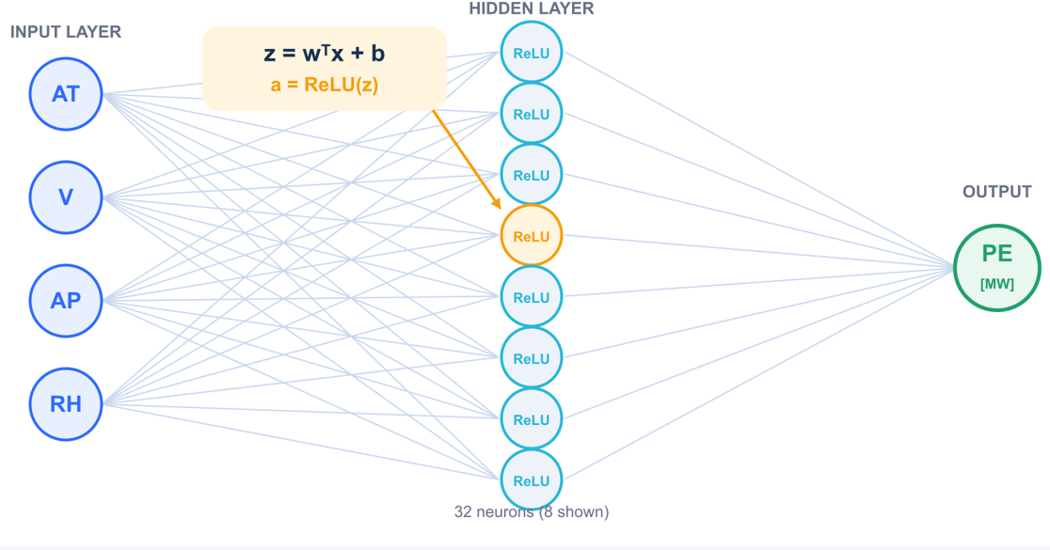

Regression models: predicting power-plant output
Inputs: temperature, vacuum, pressure and humidity → Output: electrical power in MW
Linear regression
Decision tree
Neural network
$$\hat{y}=β_{0}+β_{1}x_{1}+⋯+β_{p}x_{p}$$
Inputs → neurons → predicted MW
Combines the inputs using a weighted sum.
Simple, fast and interpretable.
Works well when relationships are approximately linear.
Learns a sequence of if–then rules.
Captures nonlinear relationships and interactions.
Deep trees may overfit, so we must control their depth.
Combines many weighted transformations.
Can learn flexible nonlinear relationships.
Requires scaled inputs for reliable training.
4

Slide 5
Case 1: Combined-cycle power plant
A gas turbine generates electricity, while its hot exhaust produces steam to drive a second turbine and recover additional power.
Ambient temperature, pressure, humidity and exhaust vacuum influence the plant’s net electrical output.
The goal is to forecast available power in megawatts for day-ahead generation planning.
5

Slide 6
Case 1: Combined-cycle power plant
Engineering motivation
Given tomorrow’s weather conditions, how many megawatts can the plant safely promise to the grid?
Inputs: Weather and operating conditions
Target: Net power output, MW
Task: Regression
Decision: How much power to commit?
6

Slide 7
Case 1: Combined-cycle power plant
Real 480 MW-class combined-cycle power plant
9,568 hourly full-load observations
Variable | Meaning | Role
AT | Ambient temperature (°C) | Input
V | Exhaust vacuum (cm Hg) | Input
AP | Ambient pressure (mbar) | Input
RH | Relative humidity (%) | Input
PE | Net electrical output (MW) | Target
$$X=\left(AT,V,AP,RH\right)⟶y=PE$$
7

Slide 8
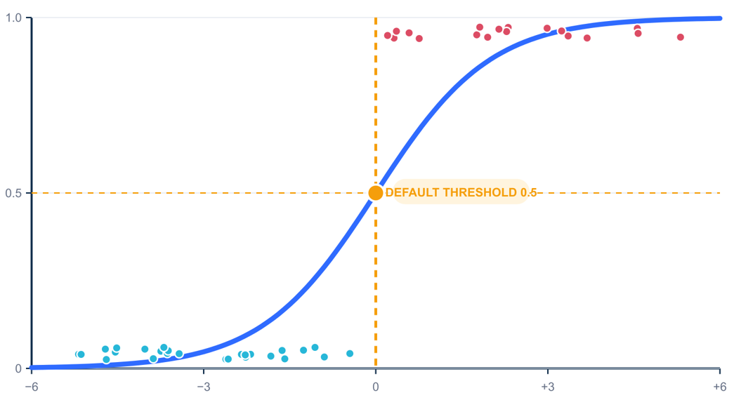
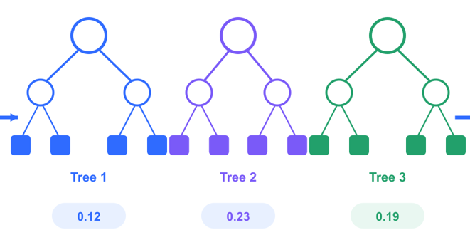

Classification model: predicting equipment failure
Sensor measurements → Failure probability → Maintenance alarm
Balanced logistic regression
Decision tree classifier
Random forest
$$p\left(\text{failure}\right)=σ\left(β_{0}+β^{T}x\right)$$
Converts a weighted input score into a probability.
Uses greater class weight for rare failures.
Often catches more failures but may create more false alarms.
Uses the same if–then structure as the regression tree.
Classification leaves contain class probabilities rather than MW values.
Captures nonlinear thresholds without feature scaling.
Combines predictions from many diverse trees.
Usually more stable than one decision tree.
Used as the candidate alarm model in the exercise.
8

Slide 9
Case 2: CNC (computer numerical control) milling machine
A milling machine removes material using a rotating cutting tool operating under changing speed, torque, temperature and tool-wear conditions.
Failures are rare and can result from interactions between load, heat, rotational speed and accumulated wear.
The goal is to predict failure risk and decide when to raise a maintenance alarm.
9

Slide 10
Case 2: CNC (computer numerical control) milling machine
Engineering motivation
Given the current sensor measurements and machine condition, should an alarm be raised for an impending failure?
Inputs: Temperature, speed, torque, wear
Target: Failure or healthy
Task: Classification
Decision: Should maintenance be triggered?
10

Slide 11
Case 2: CNC (computer numerical control) milling machine
Physics-based synthetic CNC-machine dataset.
10,000 operating records.
Variable | Meaning | Role
Type | Machine type: L, M or H | Input
Air temperature | Ambient air temperature (K) | Input
Process temperature | Machine process temperature (K) | Input
Rotational speed | Tool rotation speed (rpm) | Input
Torque | Applied torque (Nm) | Input
Tool wear | Accumulated tool wear (min) | Input
Machine failure | Failure: yes or no | Target
$$X=\left(\text{temperature}\text{, }\text{speed}\text{, }\text{torque}\text{, }\text{wear}\text{, }\text{type}\right)⟶y∈\{\text{healthy},\text{failure}\}$$
11

